Slide 1


ITC 6000 Database Management Systems Final Project Presentation Year Term B Loan Prediction Database Management System
Rajan Rajeshrao Deshpande
Deshpande.raj@northeastern.edu

Slide 2

Project Overview
Predicts loan risks based on customer demographics and financial data.
Supports loan officers in approving or rejecting applications.
Minimizes loan defaults, improves loan portfolio quality.
Integrates machine learning for predictive analytics.
Subscription-based cost model for financial institutions.

Slide 3

Personas
1. Loan Officers:
Review loan applications, and customer profiles.
Use risk predictions for informed decisions.
Approve/reject applications.
2. Data Analysts:
Analyze customer demographics, and loan trends.
Generate risk and portfolio insights.
Support strategic decision-making.
3. System Administrators:
Maintain database integrity and security.
Update and retrain predictive models.
Ensure high availability and performance.

Slide 4

Business Rules
A customer can submit multiple loan applications.
Each loan application is linked to a single customer.
Risk assessment includes risk flag (high, medium, low).
Loan officers manage applications, review predictions.
Data analysts create reports on trends and risks.
Additional Rules:
Each prediction links to a loan application.
Risk flag and probability score are model outputs.
System admins retrain prediction models periodically.

Slide 5

ERD Diagram
ER Diagram & Relations
Primary Table | Related Table | Relationship Type | Key Connections
Customer | Loan Application | 1 | Customer.customer_id → Loan Application.customer_id
Loan Application | Prediction | 01:01 | Loan Application.application_id → Prediction.application_id
Loan Officer | Loan Application | M | Loan Officer.officer_id → Loan_Officer_Application.officer_id
 |  | (via Loan_Officer_Application) | Loan Application.application_id → Loan_Officer_Application.application_id
Data Analyst | Loan Application / Prediction | M | Data Analyst.analyst_id → Data_Analyst_Application.analyst_id
 |  | (via Data_Analyst_Application) | Loan Application.application_id → Data_Analyst_Application.application_id
System Administrator | N/A (Manages System) | Independent | Administers data integrity and predictive model updates

Slide 6
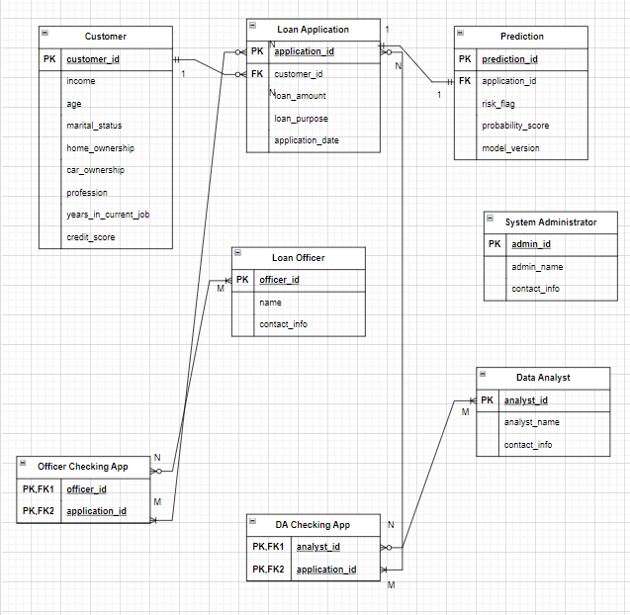
ER Diagram
.

Slide 7
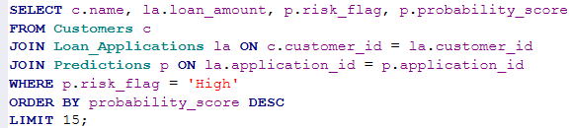
SQL Example 1
Description: Retrieve high-risk loan applications
SQL Query:
This query retrieves 15 TOP records for Loan approver officer to just reject first 15 applications who’s flag is high risk
It demonstrate with the help of given 2 tables we can directly eliminate high risk loan applicants
This is useful for loan approver.

Slide 8
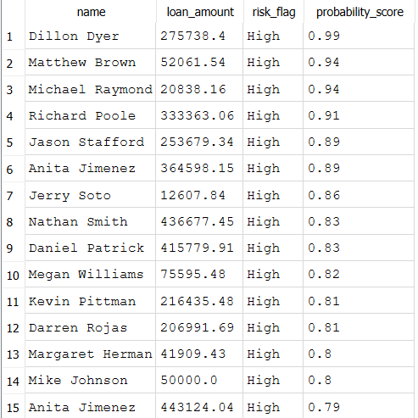
SQL Example 1
Output:-

Slide 9
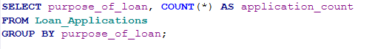
SQL Example 2
Description: Count of applications by purpose.
SQL Query:
This query retrieves the purpose of loan request.
This query helps data analysts and loan approver just to check and offer discounts on which loan so that trends can be increased.

Slide 10
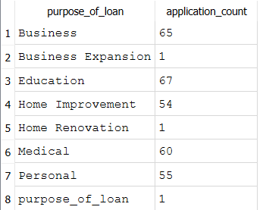
SQL Example 2
Output:-

Slide 11
Metrics and Analytics
Metrics by Persona:
1. Loan Approval Trends: Monthly trends of approved vs. rejected applications.
2. Risk Analysis: Distribution of risk categories across different loan purposes.
3. Customer Segmentation: Analysis of customer demographics by loan amount and risk level.
4. Performance Metrics: Evaluation of loan officers based on application outcomes.
5. Audit Reports: Logs detailing critical system changes for compliance.

Slide 12
Security and Privacy Concerns
Sensitive data: Customer income, credit score, and loan details.
Encryption: All data encrypted at rest and in transit.
Role-based access control to restrict unauthorized access.
Compliance with financial data regulations.

Slide 13
Lessons Learned
Next Steps:
Enhance predictive model accuracy with more data.
Add real-time fraud detection.
Improve reporting and visualization tools.
Lessons Learned:
Importance of clear business requirements.
Effective database design ensures scalability and performance.
Collaboration between data engineering and business stakeholders is key.

